Slide 1
FLIGHT DATA ANALYTICS
Peter Kinyanjui Mwaura

Slide 2
Overview
Flight Data Analytics analyses aviation accident data with the aim of identifying risks and offers actionable insights that are data driven suitable for expansion into the aviation sector
This project seeks to answer questions on:
Aircraft acquisition
Safety equipment investments
Staff training supporting operations

Slide 3
Business understanding
Business Problem:
Determine most suitable aircraft models for purchase
Identify necessary safety equipment
Outline training programs required for staff and pilots
Objective
Leverage data to mitigate risk, prioritize safety and optimize investment

Slide 4
Data understanding
The data set is from the National Transportation Safety Board(NTSB) and it contained accidents from 1948-2022
The analysis was however filtered(2017-2022) to ensure data is up to date and relevant to the modern times

Slide 5
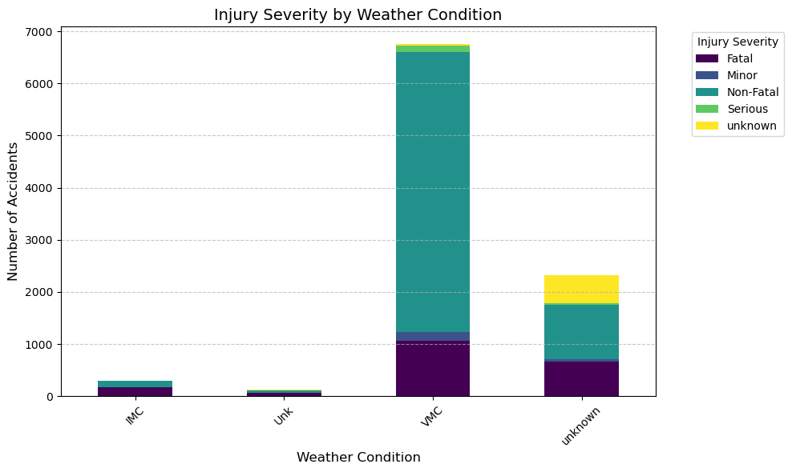
Analysis
Most accidents, though non-fatal, occur during clear skies(Visual Meteorological Conditions)

Slide 6
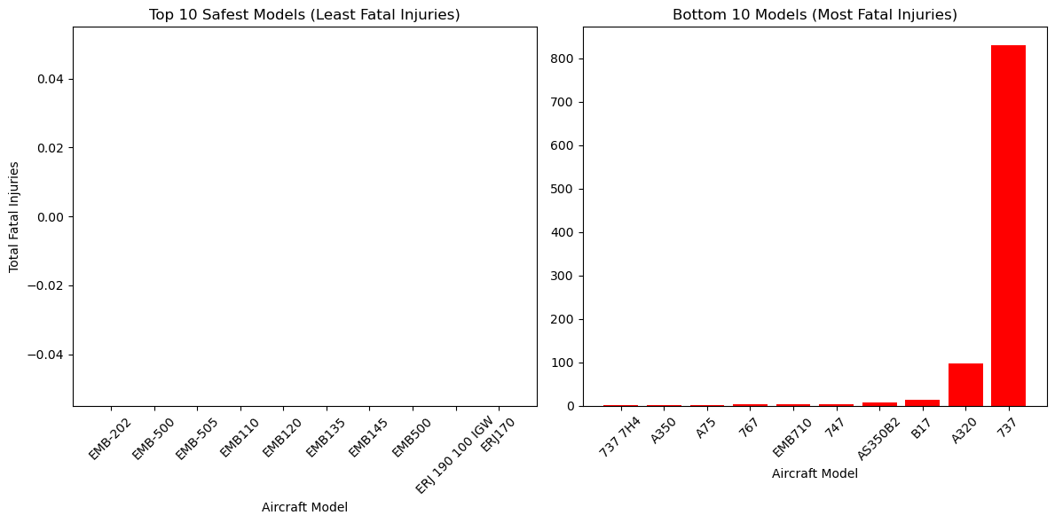
Analysis
Aircraft safety standards are high with minimal differences per accident across models

Slide 7
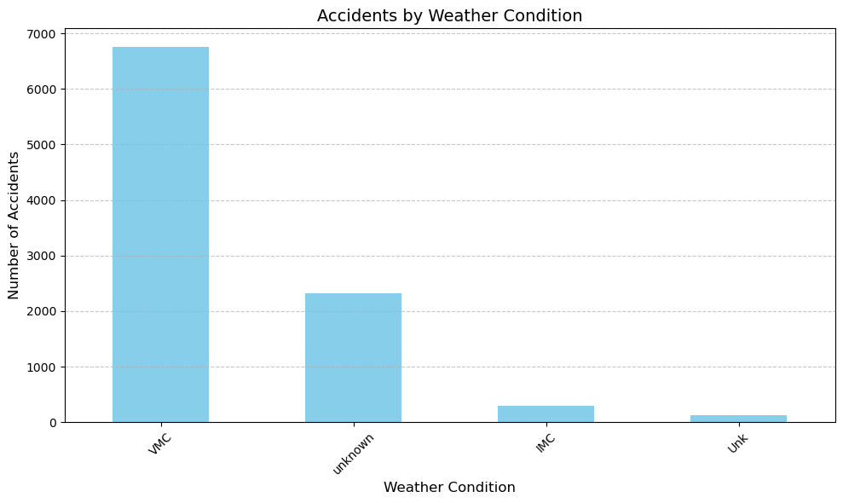
Analysis
Majority of accidents occur in clear weather emphasizing the importance of situational awareness during Visual Flight Rules(VFR)

Slide 8
recommendations
1.Invest in advanced training programs for pilots to enhance navigational skills and advanced situational awareness.
This is because most accidents happen during clear skies/ visual meteorological conditions suggesting that over reliance in visual references leads to errors.
2.Consider other factors such as RELIABILITY,EFFICIENCY,VERSATILITY AND PRICE while purchasing aircrafts instead of accident data.
This is because even though we can clearly see the Airbus A320 and Boeing 737 have more accidents than the rest its crucial to note that it's not a reflection on poor safety. These two are the most widely used planes
3.Adopt advanced navigation and auto pilot systems to enhance safety even clear weather conditions
Most accidents happen during VFR conditions which are deceptively safer but pose unique challenges

Slide 9
Next steps
Fleet Evaluation:
Analyze operational costs, fuel efficiency, and maintenance records of candidate aircraft.
Safety Enhancements:
Prioritize safety equipment investments based on cost-benefit analysis.
Collaborative Training Programs:
Partner with aviation training providers to enhance staff readiness and safety culture.

Slide 10
THANK YOU!!
ANY QUESTIONS?
Presentation done by Peter Kinyanjui Mwaura
Email: kinyashmwaura@gmail.com
Github: https://github.com/idreamofunicorns

